Slide 1
Interpolation and Easing

Slide 2

Introduction
For a long time, interpolation was used to provide an estimate of a tabulated function at values not available in a table.
What is $\sin{0.15}$?
x | sin(x)
0 | 0.0000
0.1 | 0.0998
0.2 | 0.1987
0.3 | 0.2955
0.4 | 0.3894
Using Linear Interpolation (4 decimals) $\sin{0.15≈0.998+\frac{0.1987−0.998}{2}=0.1493}$
True value $\sin{0.15=0.1494}$

Slide 3

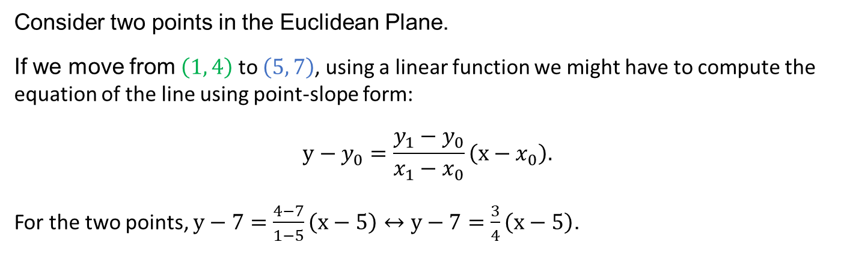

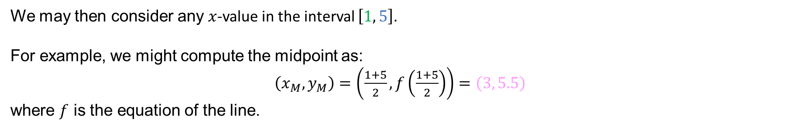

Interpolation: Motivation
Interpolation is a blending of two values. In the game world, we often view this blending as a continuous set of operations between two points.
(The fluidity makes blending look continuous, but it is discrete.)
Consider two points in the Euclidean Plane.
If we move from $\left(1, 4\right)$ to $\left(5, 7\right)$, using a linear function we might have to compute the equation of the line using point-slope form:
$$y−y_{0}=\frac{y_{1}−y_{0}}{x_{1}−x_{0}}\left(x−x_{0}\right).$$
For the two points, $y−7=\frac{4−7}{1−5}\left(x−5\right)↔y−7=\frac{3}{4}\left(x−5\right)$.
$$\left(5, 7\right)$$
$$\left(3, 5.5\right)$$
$$\left(1, 4\right)$$
We may then consider any $x$-value in the interval $\left[1, 5\right]$.
For example, we might compute the midpoint as:
$\left(x_{M},y_{M}\right)=\left(\frac{1+5}{2},f\left(\frac{1+5}{2}\right)\right)=\left(3, 5.5\right)$
where $f$ is the equation of the line.

Slide 4



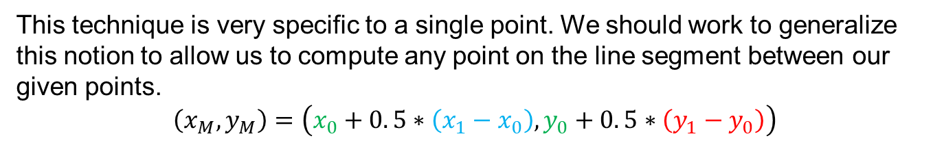



Interpolation: Motivation II
To acquire a blending of points, we do not want to compute the function $f$ that passes through the two points, we want to compute individual points along that line.
Consider again computing the midpoint of the two points.
We are well-aware of a formula for doing so:
$$\left(x_{M},y_{M}\right)=\left(\frac{x_{0}+x_{1}}{2},\frac{y_{0}+y_{1}}{2}\right)=\left(\frac{1+5}{2},\frac{4+7}{2}\right)=\left(3, 5.5\right)$$
$$\left(3, 5.5\right)$$
$$\left(5, 7\right)$$
$$\left(1, 4\right)$$
$$y_{1}−y_{0}$$
$$x_{1}−x_{0}$$
This technique is very specific to a single point. We should work to generalize this notion to allow us to compute any point on the line segment between our given points.
$$\left(x_{M},y_{M}\right)=\left(x_{0}+0. 5∗\left(x_{1}−x_{0}\right),y_{0}+0. 5∗\left(y_{1}−y_{0}\right)\right)$$
For this example,
$$\left(x_{M},y_{M}\right)=\left(1+0. 5∗\left(5−1\right),4+0. 5∗\left(7−4\right)\right)=\left(3, 5.5\right)$$

Slide 5

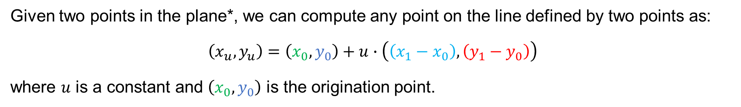


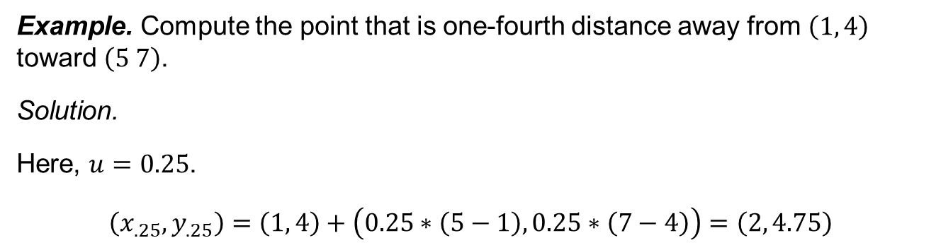
Interpolation: Motivation III
Given two points in the plane*, we can compute any point on the line defined by two points as:
$$\left(x_{u},y_{u}\right)=\left(x_{0},y_{0}\right)+u∙\left(\left(x_{1}−x_{0}\right), \left(y_{1}−y_{0}\right)\right)$$
where $u$ is a constant and $\left(x_{0},y_{0}\right)$ is the origination point.
$$\left(5, 7\right)$$
$$\left(2, 4.75\right)$$
$$y_{1}−y_{0}$$
Example. Compute the point that is one-fourth distance away from $\left(1, 4\right)$ toward $\left(5 7\right)$.
Solution.
Here, $u=0.25$.
$$\left(x_{.25},y_{.25}\right)=\left(1, 4\right)+\left(0.25∗\left(5−1\right), 0.25∗\left(7−4\right)\right)=\left(2, 4.75\right)$$
$$\left(1, 4\right)$$
$$x_{1}−x_{0}$$
*This can easily be extended to $n$ dimensions.

Slide 6


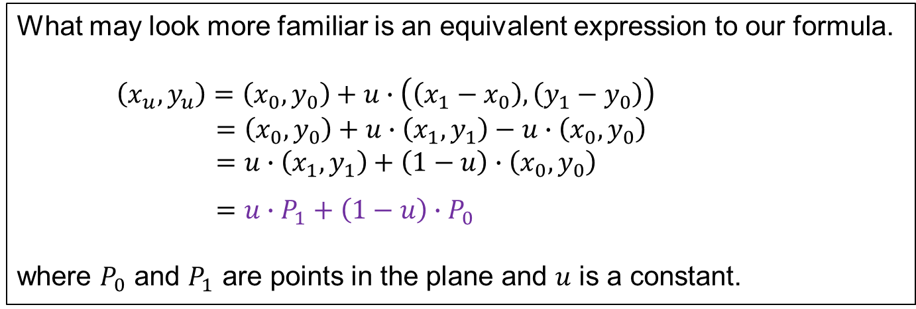



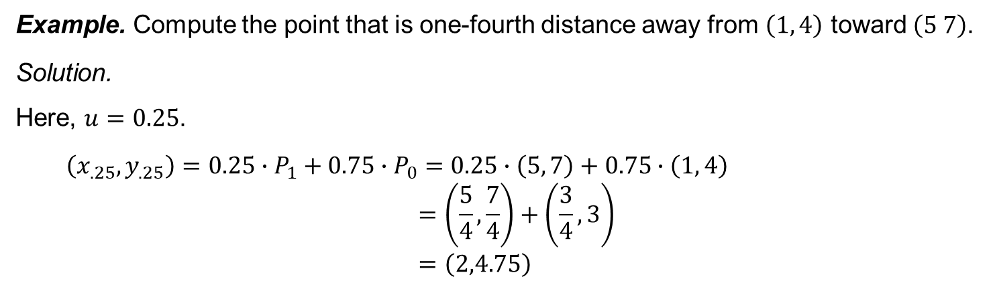
Linear Interpolation
What may look more familiar is an equivalent expression to our formula.
$$\left(x_{u},y_{u}\right)=\left(x_{0},y_{0}\right)+u∙\left(\left(x_{1}−x_{0}\right), \left(y_{1}−y_{0}\right)\right)$$
$=\left(x_{0},y_{0}\right)+u∙\left(x_{1},y_{1}\right)−u∙\left(x_{0},y_{0}\right)$
$=u∙\left(x_{1},y_{1}\right)+\left(1−u\right)∙\left(x_{0},y_{0}\right)$
$=u∙P_{1}+\left(1−u\right)∙P_{0}$
where $P_{0}$ and $P_{1}$ are points in the plane and $u$ is a constant.
$$P_{1}$$
$$\left(x_{u},y_{u}\right)$$
$$y_{1}−y_{0}$$
$$P_{0}$$
$$x_{1}−x_{0}$$
Example. Compute the point that is one-fourth distance away from $\left(1, 4\right)$ toward $\left(5 7\right)$.
Solution.
Here, $u=0.25$.
$$\left(x_{.25},y_{.25}\right)=0.25∙P_{1}+0.75∙P_{0}=0.25∙\left(5, 7\right)+0.75∙\left(1, 4\right)$$
$$=\left(\frac{5}{4},\frac{7}{4}\right)+\left(\frac{3}{4},3\right)$$
$$=\left(2,4.75\right)$$

Slide 7


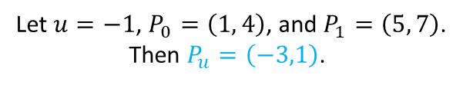

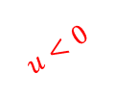

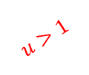




Linear Extrapolation
$P_{u}=u∙P_{1}+\left(1−u\right)∙P_{0}$
Let $P_{0}$ and $P_{1}$ be points in the plane. If $u=0$ or $u=1$ what points will we acquire on the line that is defined by $P_{0}$ and $P_{1}$?
$P_{0}$ when $u=0$ and $P_{1}$ when $u=1$
$$u>1$$
If $0<u<1$, what points will we acquire on the line that is defined by $P_{0}$ and $P_{1}$?
$$P_{1}$$
All points between $P_{0}$ and $P_{1}$
$$0<u<1$$
$$u=1$$
If $u>1$, what points will we acquire on the line that is defined by $P_{0}$ and $P_{1}$?
$$u=0$$
$$u<0$$
$$P_{0}$$
All points 'beyond' $P_{1}$ (the open interval ending with $P_{1}$)
If $u<0$, what points will we acquire on the line that is defined by $P_{0}$ and $P_{1}$?
All points 'beyond' $P_{0}$ (the open interval ending with $P_{0}$)
Let $u=−1$, $P_{0}=\left(1, 4\right)$, and $P_{1}=\left(5, 7\right)$.
Then $P_{u}=\left(−3,1\right)$.
When $\left|u\right|>1$, we refer to this as linear extrapolation.

Slide 8
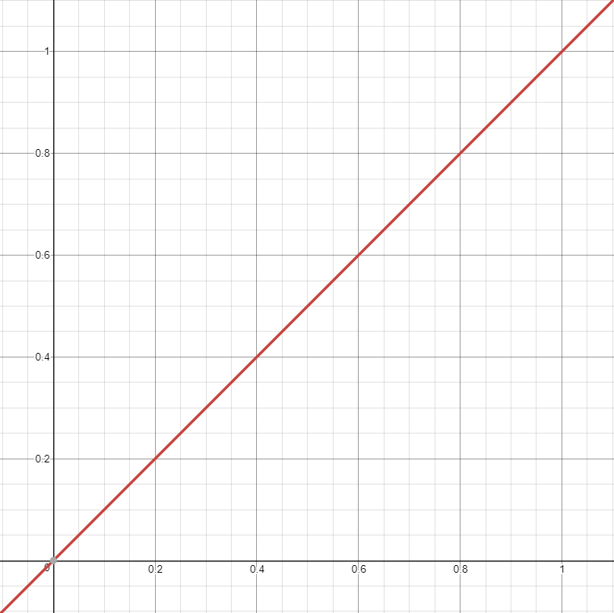
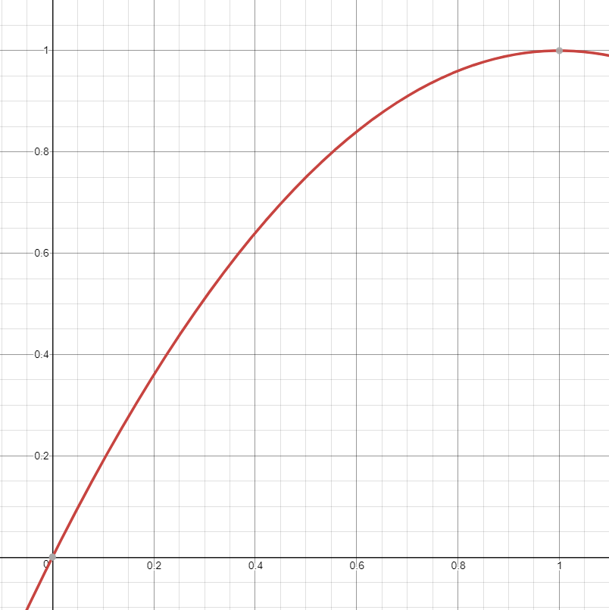
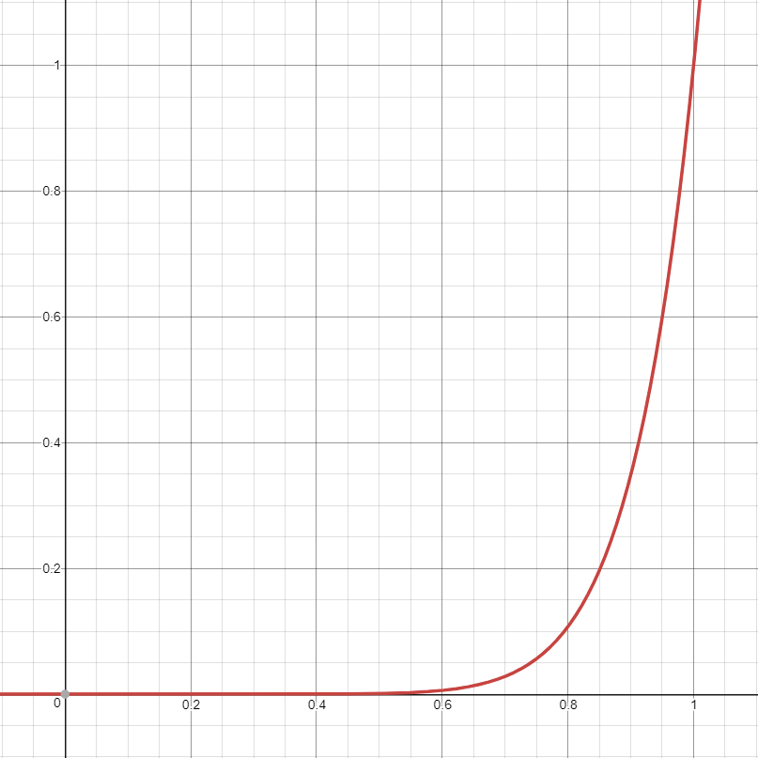



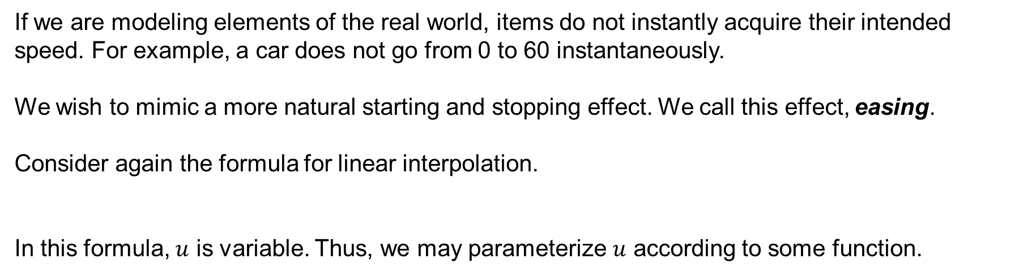
Easing
If we are modeling elements of the real world, items do not instantly acquire their intended speed. For example, a car does not go from 0 to 60 instantaneously.
We wish to mimic a more natural starting and stopping effect. We call this effect, easing.
Consider again the formula for linear interpolation.
In this formula, $u$ is variable. Thus, we may parameterize $u$ according to some function.
$P_{u}=u∙P_{1}+\left(1−u\right)∙P_{0}$
$$u^{10}$$
$$−u\left(u−2\right)$$
Linear (no easing occurring)
Easing Out
(Fast / Abrupt at beginning;
slow at the end.)
Easing In
(Slow in beginning;
fast at end.)

Slide 9

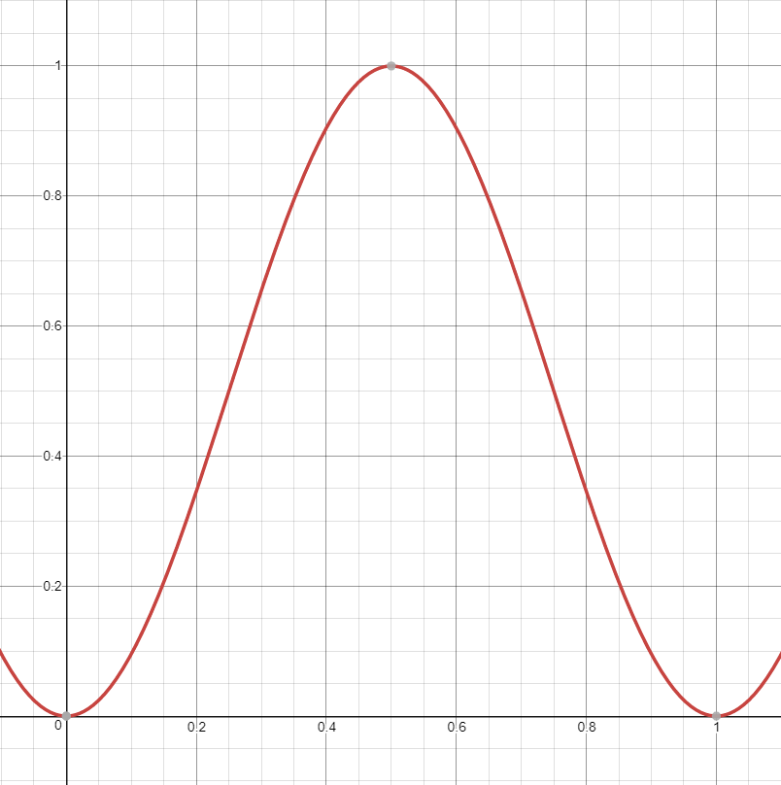

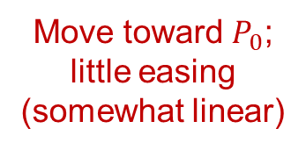
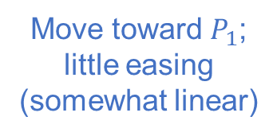
Impact of Easing Functions
$P_{u}=u∙P_{1}+\left(1−u\right)∙P_{0}$
With interpolation we are interested in computing $u$ such that $0≤u≤1$. Sometimes we place safeguards on the code to ensure this is the case:
Thus, we are usually most interested in the unit interval: $\left[0,1\right]×\left[0,1\right]$.
What is the impact of an easing function $f$ on the movement from a point $P_{0}$ to $P_{1}$? What if $f$ increases over an interval? Decreases over an interval?
Example. Consider the easing function $f \left(u\right)=\frac{1}{2}cos{2π\left(u−\frac{1}{2}\right)+\frac{1}{2}}$
Move toward $P_{1}$;
little easing (somewhat linear)
Move toward $P_{0}$;
little easing
(somewhat linear)

Slide 10
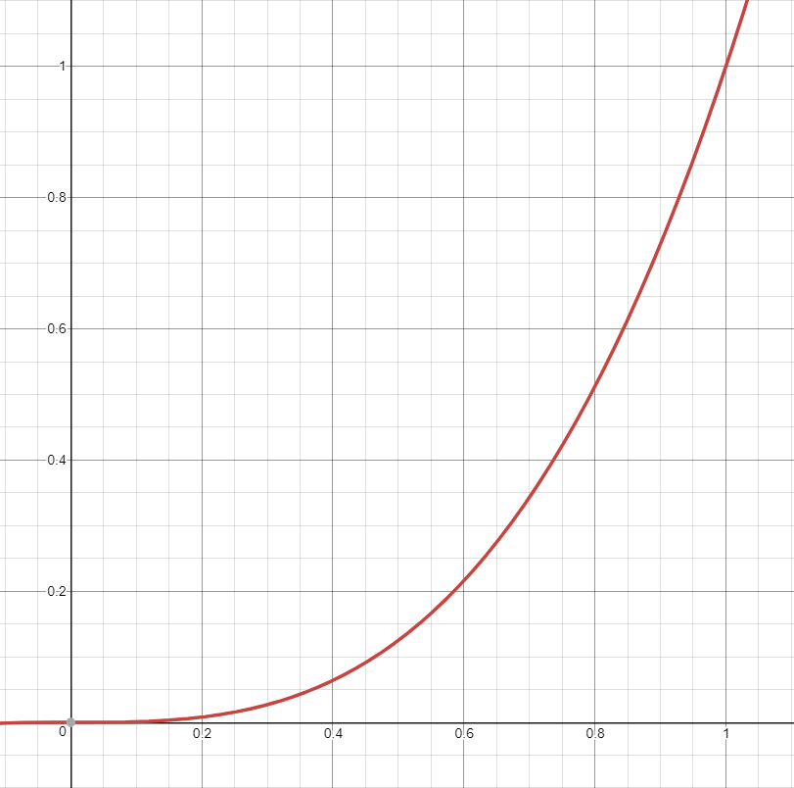
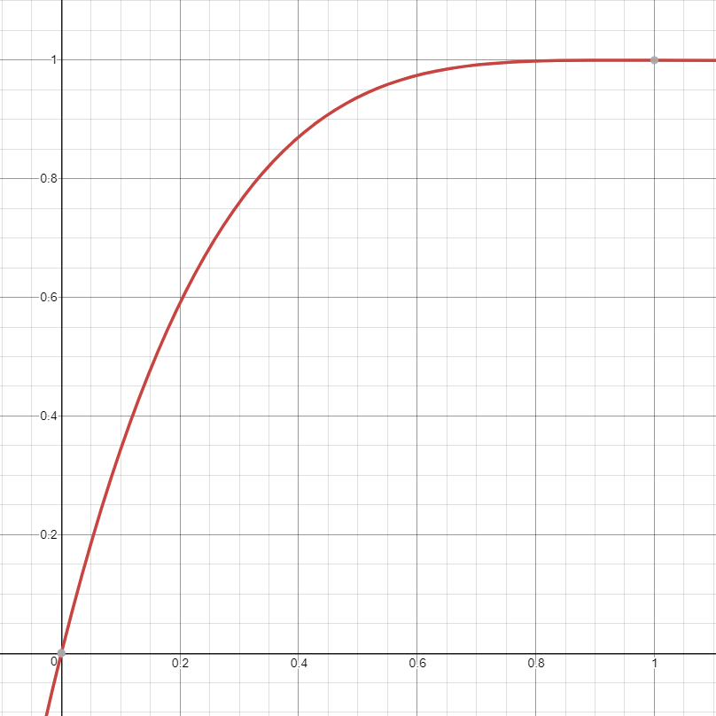
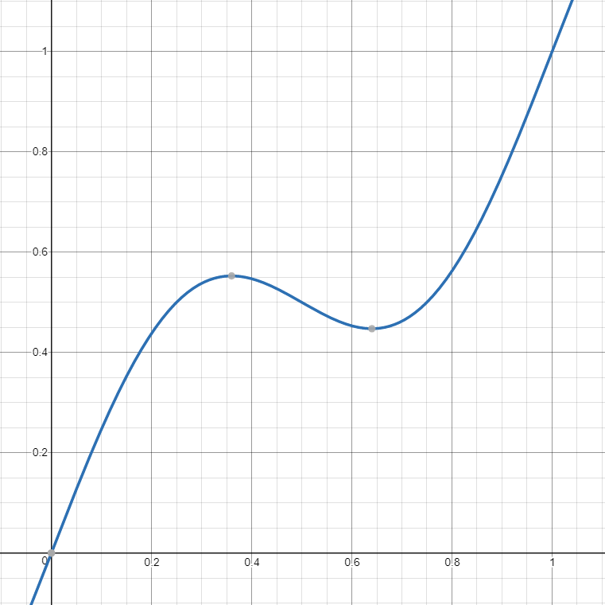
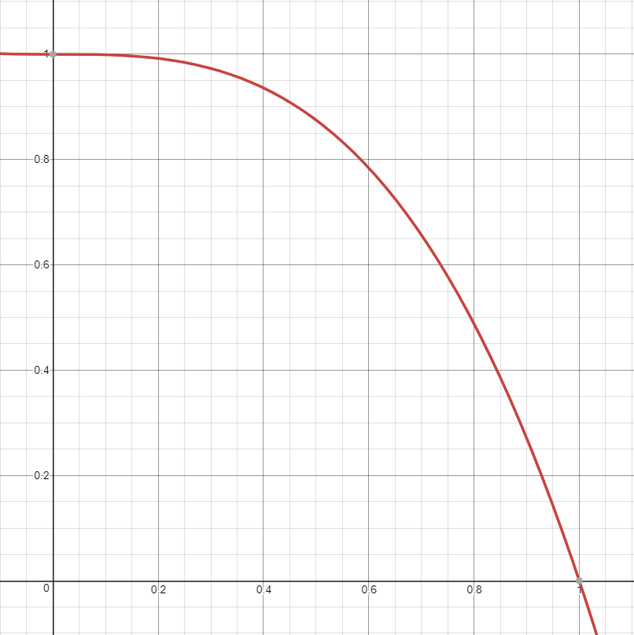
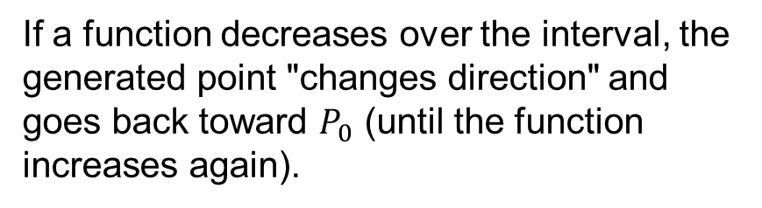
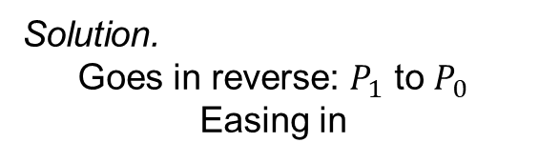
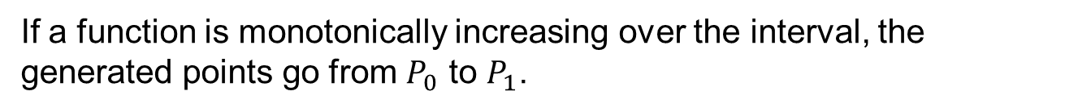
Impact of Easing Functions (cont.)
$P_{u}=u∙P_{1}+\left(1−u\right)∙P_{0}$
Generally, we can make the following claims about easing functions. Assume, the easing function passes through the point $\left(0,0\right)$.
If a function is monotonically increasing over the interval, the generated points go from $P_{0}$ to $P_{1}$.
If a function decreases over the interval, the generated point "changes direction" and goes back toward $P_{0}$ (until the function increases again).
Problem. Describe the movement of a particle based on this easing function.
Solution.
Goes in reverse: $P_{1}$ to $P_{0}$
Easing in

